Slide 1
Area Under the ROC Curve
Binary Dependent Variables:
Evaluating a Logistic Regression Model

Slide 2
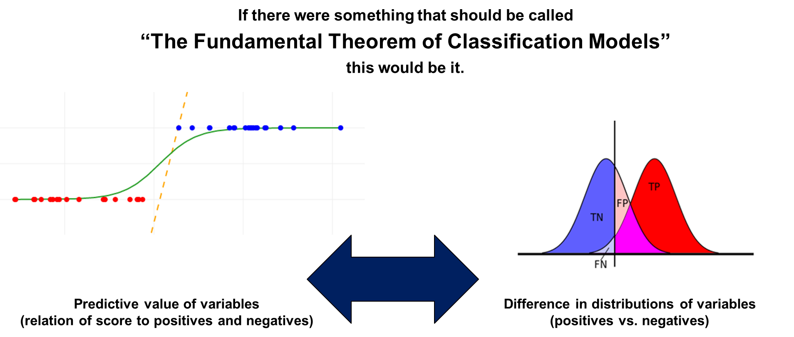
Evaluating a Logistic Regression Model
Notes:
1

Slide 3
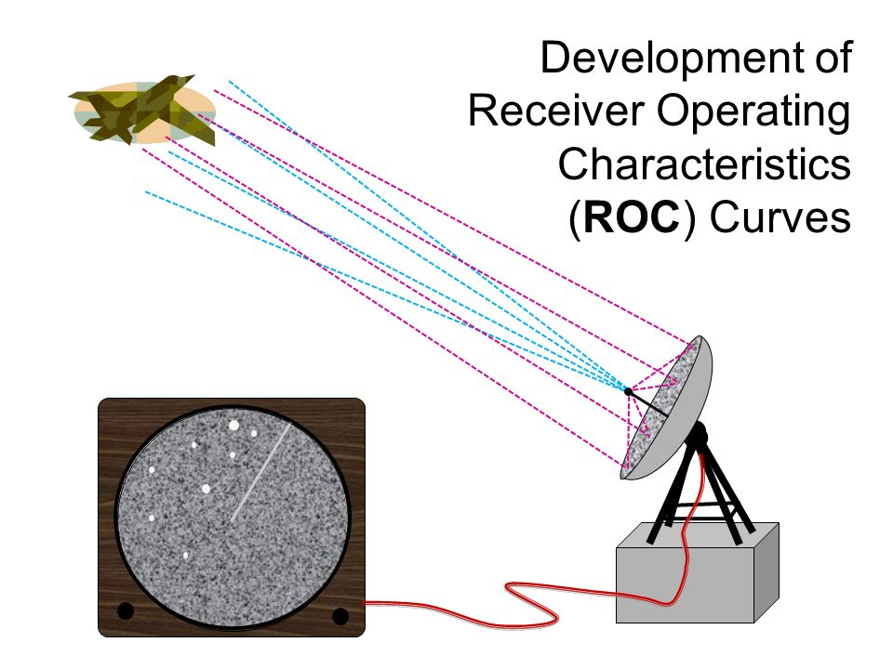
Evaluating a Logistic Regression Model: Receiver Operating Characteristic Curve
Notes:
2

Slide 4
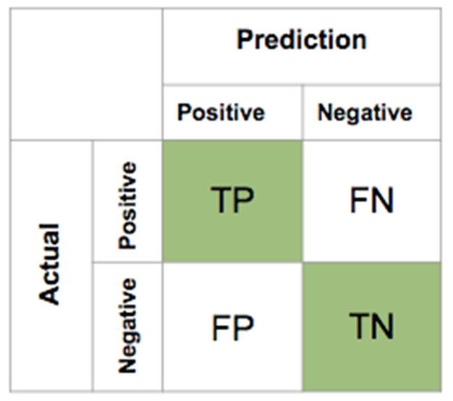
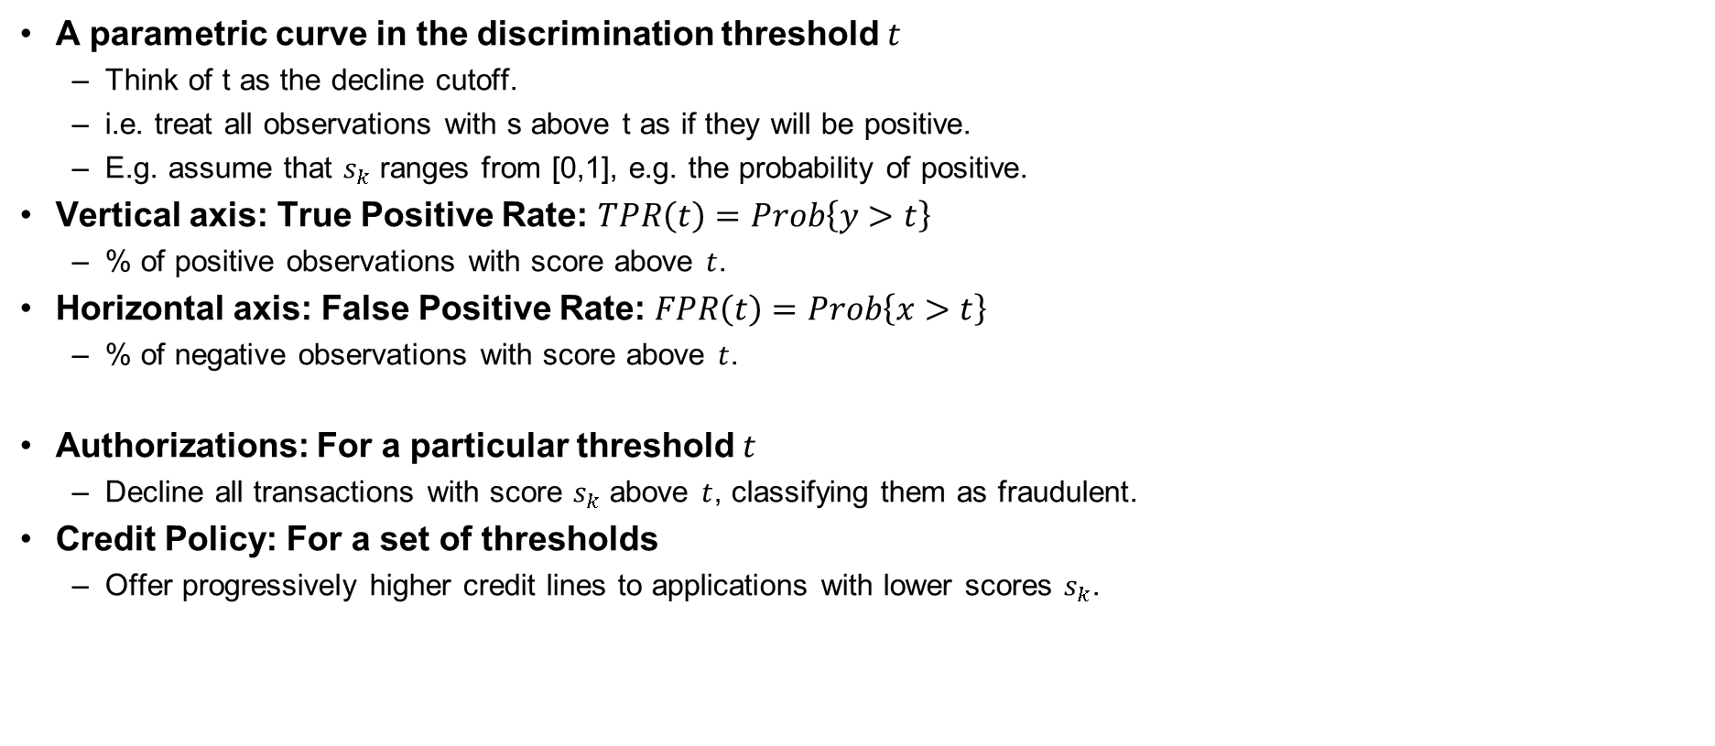
Evaluating a Logistic Regression Model: Receiver Operating Characteristic Curve
Notes:
3

Slide 5
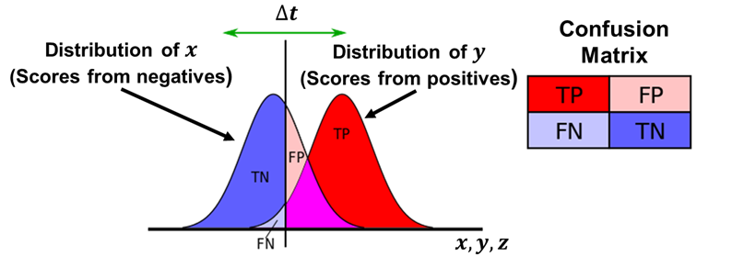
Evaluating a Logistic Regression Model
Notes:
4

Slide 6
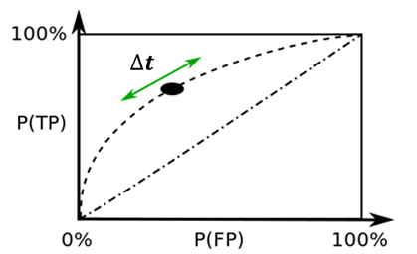
Evaluating a Logistic Regression Model: Receiver Operating Characteristic Curve
Notes:
5

Slide 7
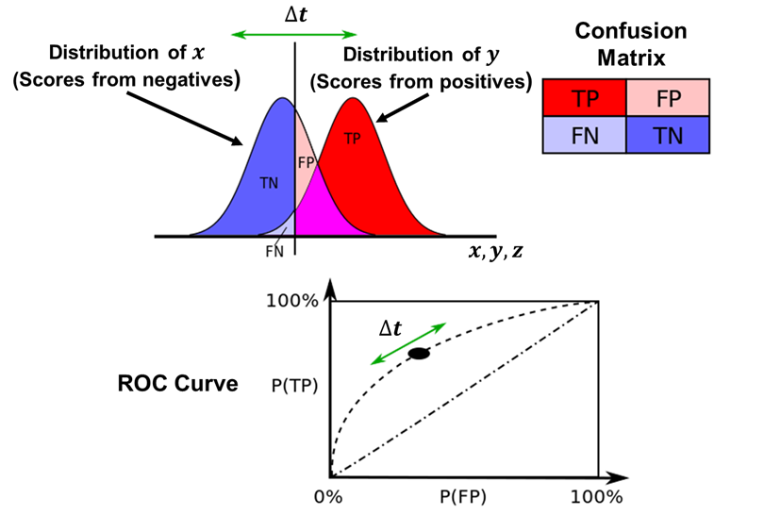
Evaluating a Logistic Regression Model: Receiver Operating Characteristic Curve
Notes:
6

Slide 8
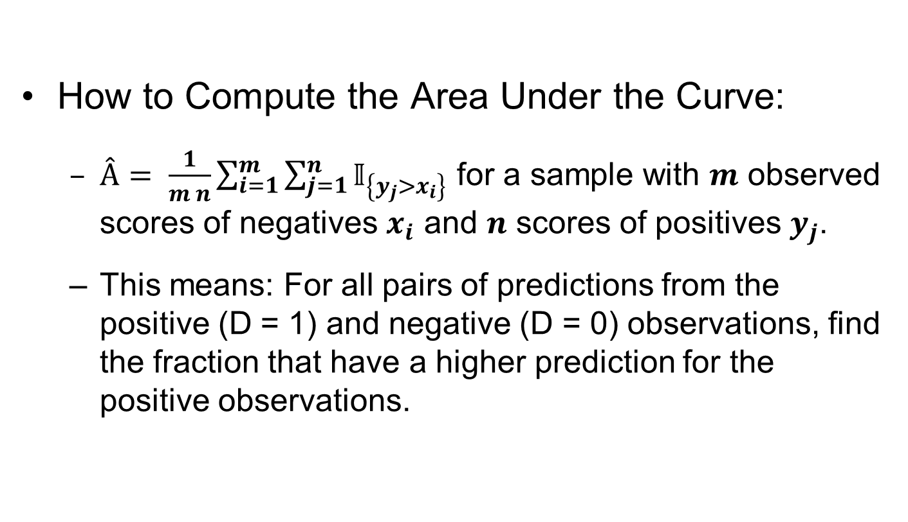
Evaluating a Logistic Regression Model: Receiver Operating Characteristic Curve
How to Compute the Area Under the Curve:
$Â= \frac{1}{m n}\sum_{i=1}^{m}{\sum_{j=1}^{n}{𝕀_{\left\{y_{j}>x_{i}\right\}}}}$ for a sample with $m$ observed scores of negatives $x_{i}$ and $n$ scores of positives $y_{j}$.
This means: For all pairs of predictions from the positive (D = 1) and negative (D = 0) observations, find the fraction that have a higher prediction for the positive observations.
Notes:
7

Slide 9
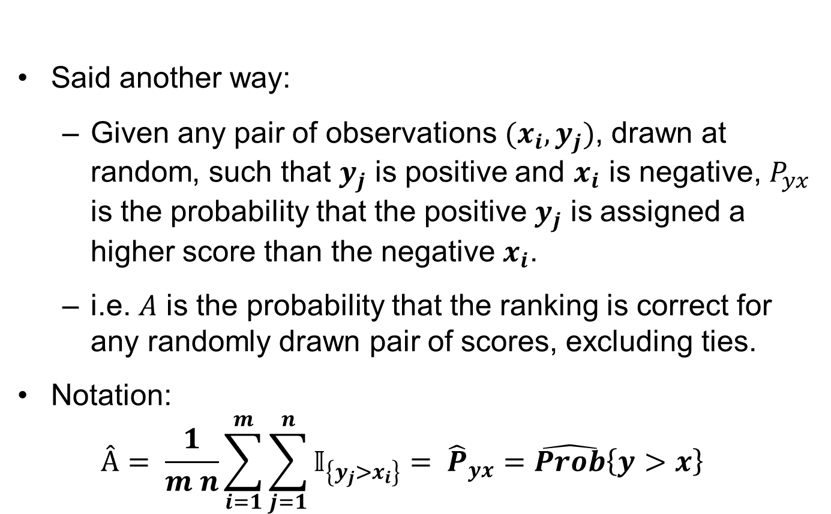
Evaluating a Logistic Regression Model: Receiver Operating Characteristic Curve
Said another way:
Given any pair of observations ${(x}_{i},y_{j})$, drawn at random, such that $y_{j}$ is positive and $x_{i}$ is negative, $P_{yx}$ is the probability that the positive $y_{j}$ is assigned a higher score than the negative $x_{i}$.
i.e. $A$ is the probability that the ranking is correct for any randomly drawn pair of scores, excluding ties.
Notation:
$$Â= \frac{1}{m n}\sum_{i=1}^{m}{\sum_{j=1}^{n}{𝕀_{\left\{y_{j}>x_{i}\right\}}}}= {\hat{P}}_{yx}=\hat{Prob}\left\{y>x\right\}$$
Notes:
8

Slide 10
Collecting Your Data
Sampling:
Sample Design and
Selection Bias

Slide 11


What’s More Likely?
Plane Crashes
Sky Diving
Accidents
Notes:
10

Slide 12
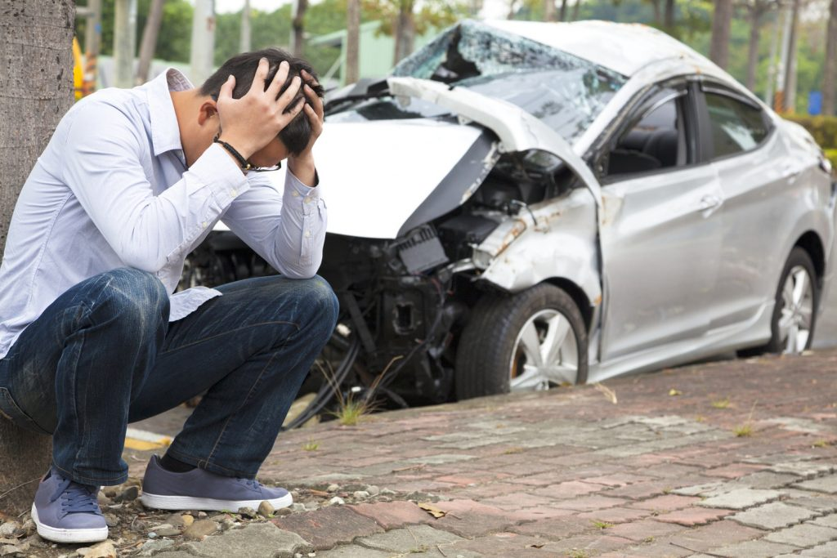
What’s More Likely?
Traffic Collisions
Sky Diving
Accidents
Notes:
11

Slide 13
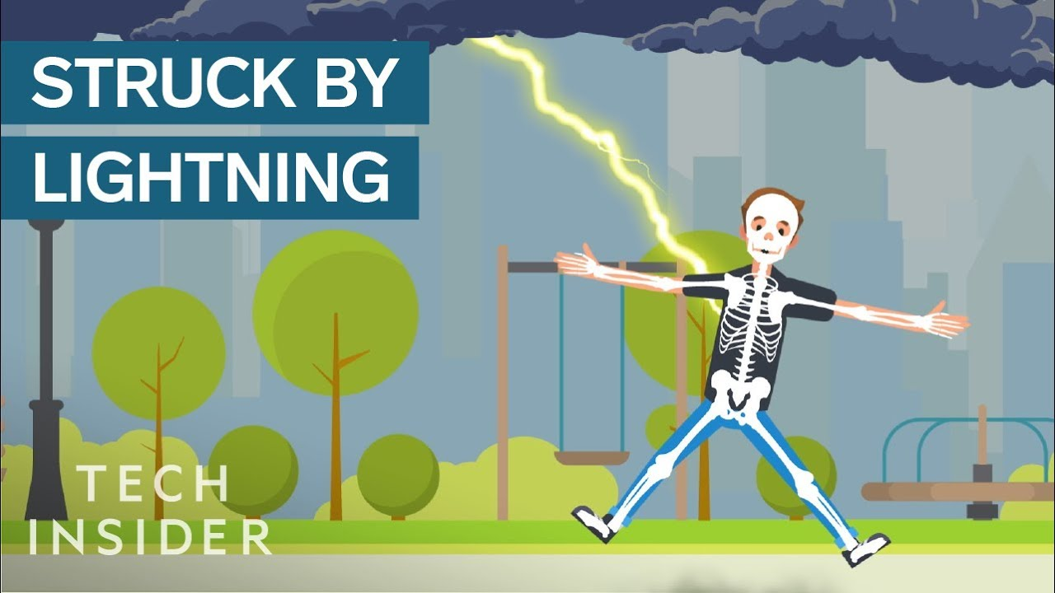
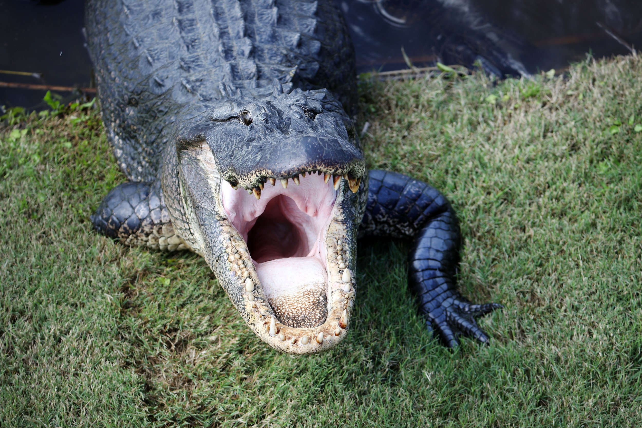
What’s More Likely?
Lightning
Strikes
Alligator
Attacks
Notes:
12

Slide 14

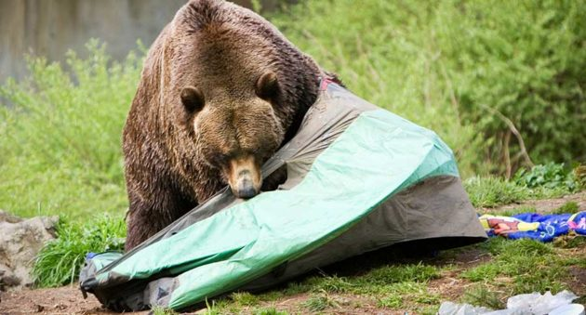
What’s More Likely?
Bear
Attacks
Injuries
From Toys
Notes:
13

Slide 15


What’s More Likely?
Shark
Attacks
Death by
Coconut
Notes:
14

Slide 16

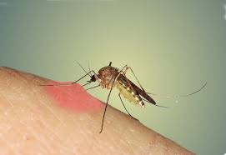


Bonus Round: What’s More Deadly?
Animal
Attacks
Mosquito
Bites
Notes:
15

Slide 17
Sampling
First, recall the definitions of some key terms:
Population: the entire group of items that interests us
Sample: the part of this population that we actually observe
Statistical inference involves using the sample to draw conclusions about the characteristics of the population from which the sample came
Notes:
16

Slide 18
Selection Bias
Any sample that differs systematically from the population that it is intended to represent is called a biased sample
One of the most common causes of biased samples is selection bias, which occurs when the selection of the sample systematically excludes or underrepresents certain groups
Selection bias often happens when we use a convenience sample consisting of data that are readily available
Self-selection bias can occur when we examine data for a group of people who have chosen to be in that group
Notes:
17

Slide 19


Selection Bias
Who is happier: Married vs single people?
Notes:
18

Slide 20

Selection Bias
Who is happier: Married vs single people?
Notes:
19

Slide 21

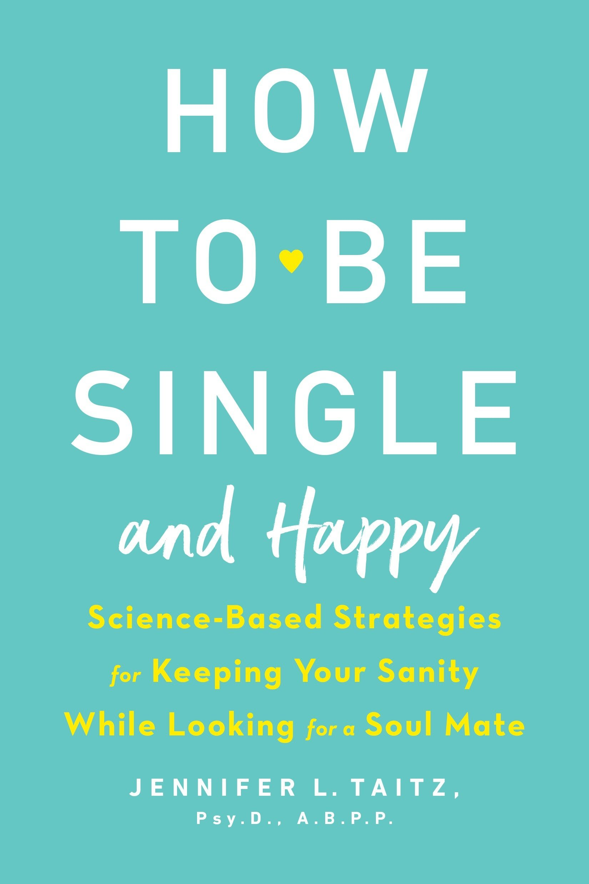
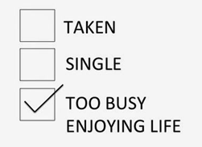
Selection Bias
Who is happier: Married vs single people?
Notes:
20

Slide 22
Selection Bias
Who is happier: Married vs single people?
Bella DePaulo studies this question:
TEDX talk
What no one ever told you about people who are single
https://www.youtube.com/watch?v=lyZysfafOAs By Bella DePaulo March 25, 2017
USA Today's Big New Story on Marriage Peddles Same Old Fallacies
USA Today features dubious claims about the implications of marrying.
https://www.psychologytoday.com/us/blog/living-single/200902/usa-todays-big-new-story-marriage-peddles-same-old-fallacies
Notes:
21

Slide 23
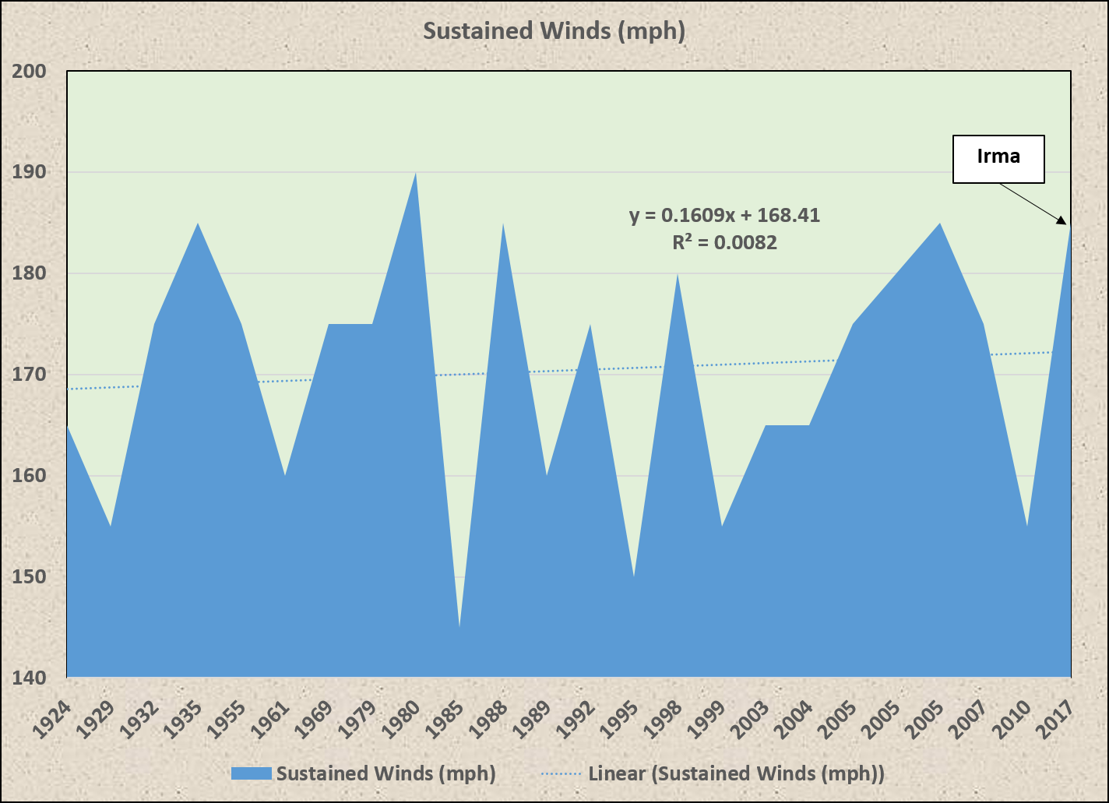
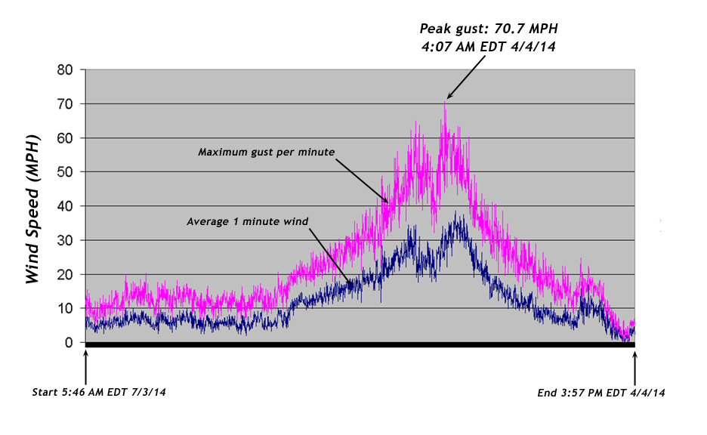
Selection Bias
Are hurricanes getting faster?
Notes:
22

Slide 24
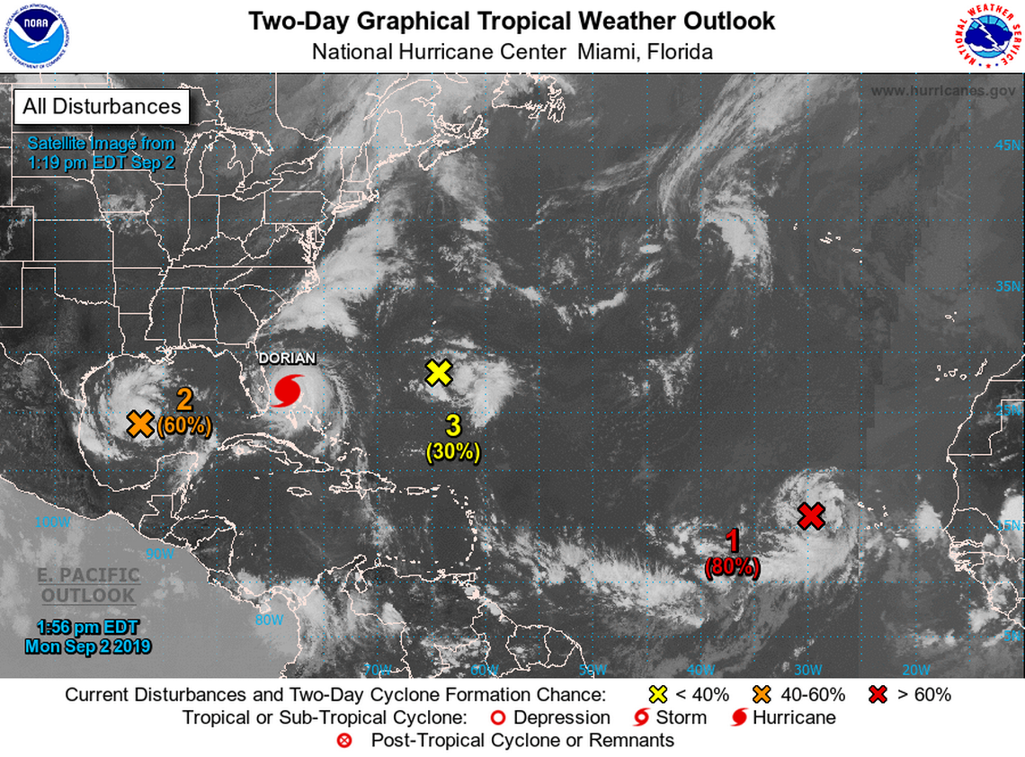
Selection Bias
Are hurricanes happening more often?
Notes:
23

Slide 25
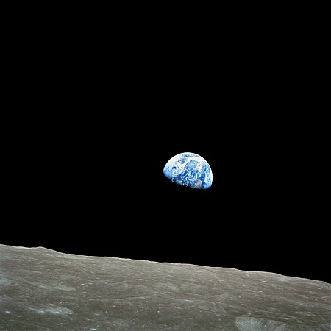
Selection Bias
Fifty years to the day after taking the photo, William Anders observed,
"We set out to explore the moon and instead discovered the Earth."
Notes:
24

Slide 26
Survivor and Nonresponse Bias
A retrospective study looks at past data for a contemporaneously selected sample
for example, an examination of the lifetime medical records of 65-year-olds
A prospective study, in contrast, selects a sample and then tracks the members over time
By its very design, retrospective studies suffer from survivor bias: we necessarily exclude members of the past population who are no longer around!
Nonresponse bias: The systematic refusal of some groups to participate in an experiment or to respond to a poll
Notes:
25

Slide 27
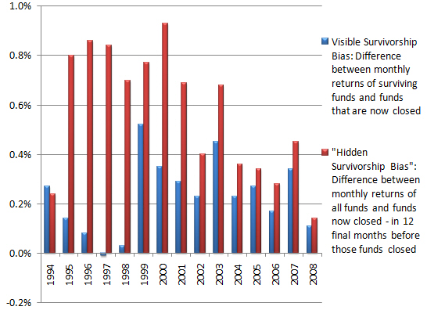
Survivor and Nonresponse Bias
Hedge Fund Returns
Often Include only the funds that still exist, i.e. those that are successful
Notes:
26

Slide 28
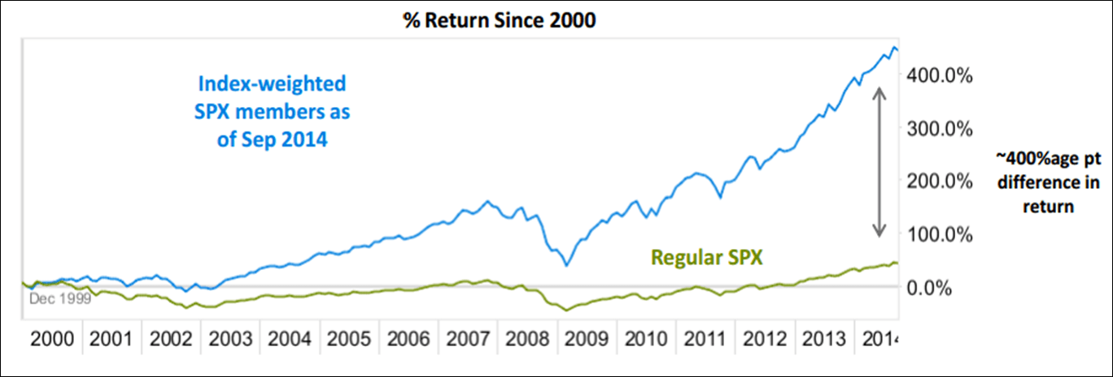
Survivor and Nonresponse Bias
Hedge Fund Returns
Often Include only the funds that still exist, i.e. those that are successful
Notes:
27

Slide 29
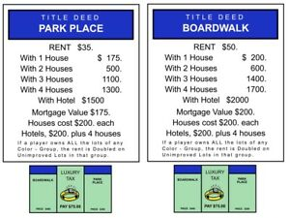
Survivor and Nonresponse Bias
How to win:
Notes:
28

Slide 30
The Power of Random Selection
In a simple random sample of size N from a given population:
each member of the population is equally likely to be included in the sample
every possible sample of size N from this population has an equal chance of being selected
How do we actually make random selections?
We would like a procedure that is equivalent to the following:
put the name of each member of the population on its own slip of paper
drop these slips into a box
mix thoroughly
pick members out randomly
In practice, random sampling is usually done through some sort of numerical identification combined with a computerized random selection of numbers
Notes:
29

Slide 31
Collecting your Data: Sampling
Lesson:
Be sure that your sample is representative of the population
Be on alert for anecdotal evidence
Avoid data that has passed through a “filter”
Drawing at random is the best policy
Ensure that you are observing the variation you need to measure what you are interested in
Notes:
30

